Slide 1






SPRING 2024
Deep Learning Presentation
Pratham Yadav
Jenil Pandya

Slide 2
WHAT ARE WE GOING TO COVER?
AGENDA:
1. Object Detection Project
1. GAN

Slide 3



OBJECT DETECTION PROJECT
OBJECTIVE
In this project, we aim to develop a computer vision model capable of accurately detecting and localizing cups, mouse, and spoons within images. The model will be trained on a dataset of images containing these objects, ensuring diversity in object poses, backgrounds, and lighting conditions. The primary challenge lies in building a robust model that can generalize well to unseen images and accurately distinguish between the three classes of objects.

Slide 4
STEPS INVOLVED
STEP 1: DATA COLLECTION
STEP 2: DATA PREPROCESSING
STEP 3: DATA ANNOTATION
STEP 4: DATASET CREATION
STEP 5: MODEL SELECTION
STEP 6: MODEL TRAINING
STEP 7: RESULT EVALUATION

Slide 5
STEP 1: DATA COLLECTION
Objective: To build a robust object detection model for cups, mice, and spoons.
Objective: To build a robust object detection model for cups, mouse, and spoons.
Method: Photographs were taken at various locations, under different lighting conditions, and from different angles.
Diversity: Ensured diverse backgrounds, poses, and orientations for each object class.
Quantity: Collected a dataset of 400 images to train the model effectively.
Quality: Images were captured with high resolution and clarity for accurate annotation

Slide 6
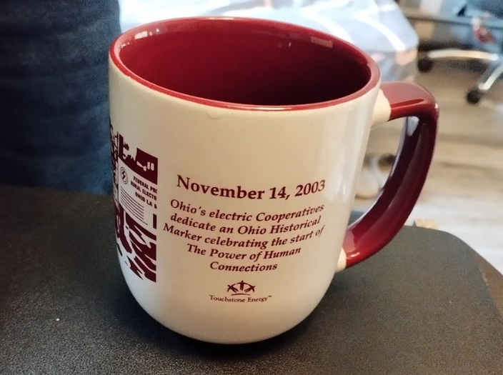
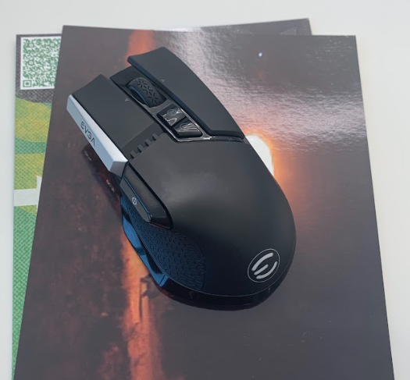
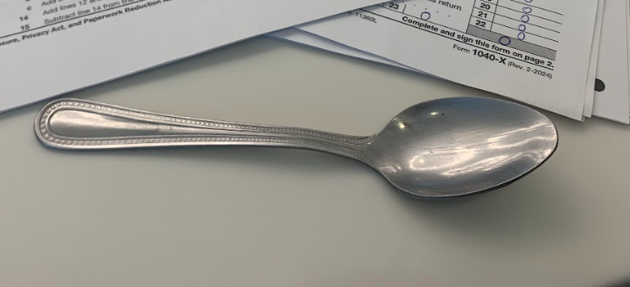
Cups
Mouse
Spoon

Slide 7
STEP 2: DATA PREPROCESSING
Objective: To build a robust object detection model for cups, mice, and spoons.
Conversion to JPG: All images were converted to JPG format for uniformity.
Standardization: Resized all images to a standard format.
HEIC to JPG: Converted HEIC images to JPG for compatibility.
Quality Preservation: Ensured minimal loss of image quality during conversion.
Uniformity: Standardized image sizes for consistent training data.

Slide 8
STEP 3: DATA ANNOTATION
Objective: To build a robust object detection model for cups, mice, and spoons.
Platform: Used Roboflow for efficient and accurate data annotation.
Manual Annotation: Created bounding boxes for each object in the images.
Efficiency: Leveraged Roboflow's tools for faster annotation.
Accuracy: Ensured precise annotation for training the object detection model.
Quality Control: Reviewed annotations to maintain high-quality dataset.

Slide 9
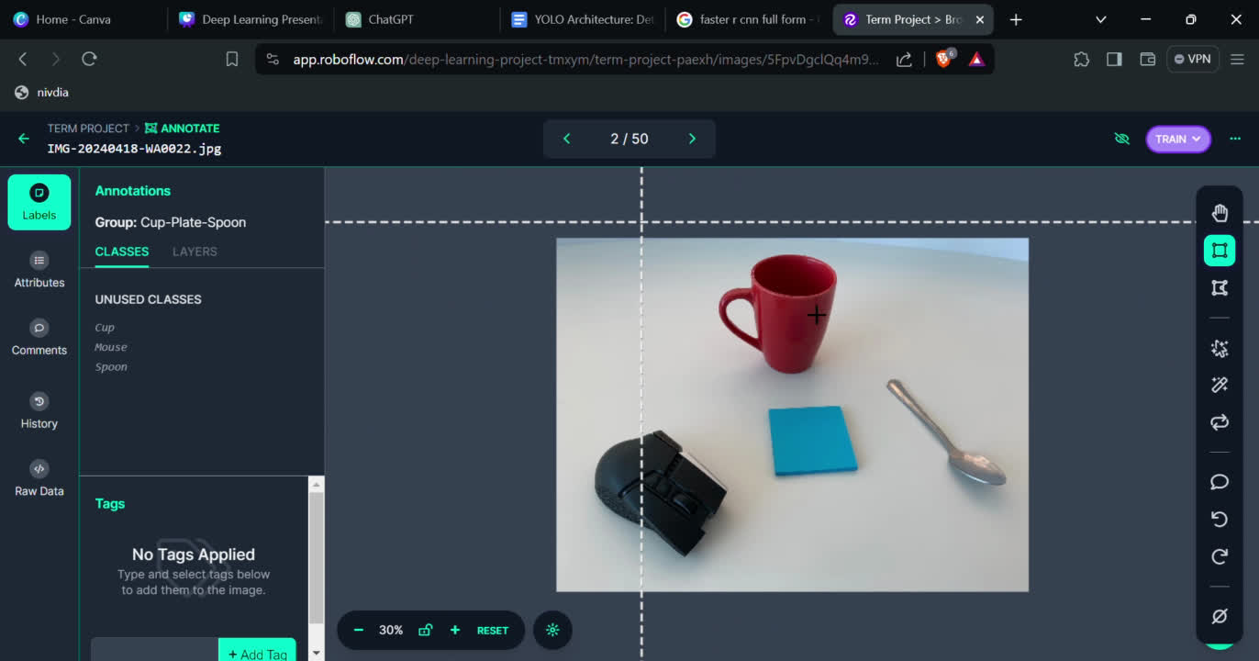

Slide 10
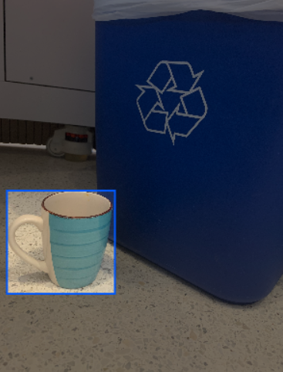
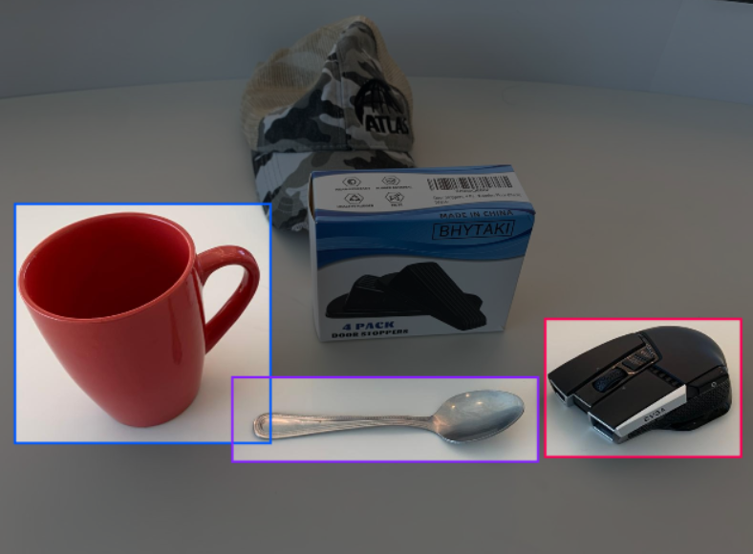
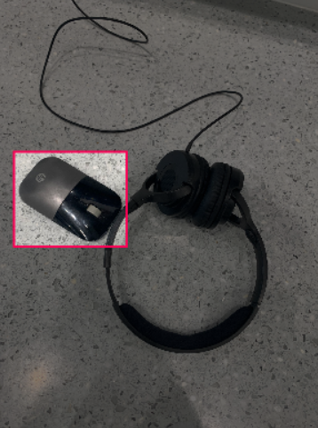
This is How Roboflow Annotation Works

Slide 11
STEP 4: DATASET CREATION
Objective: To build a robust object detection model for cups, mice, and spoons.
Splitting Data: Utilized Roboflow to split images into train, test, and validation sets.
Customization: Specified the amount of images for each set to suit project requirements.
Download: Dataset downloaded in a structured format for easy integration into the training pipeline.
XML Files: Included XML files with detailed annotations for each image.
Class Information: Each bounding box is annotated with the corresponding class name which is included in XML data.

Slide 12
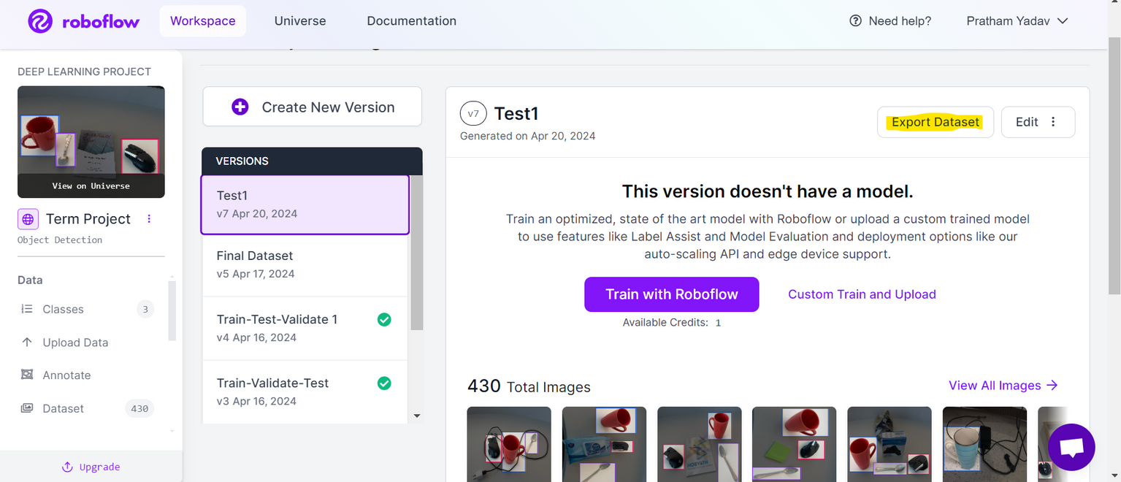
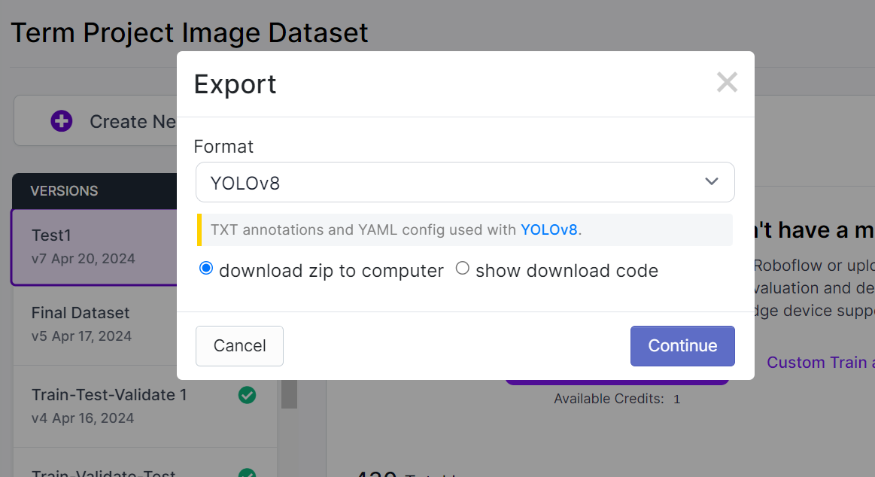
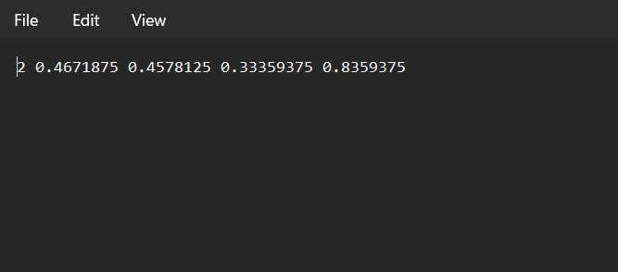

Slide 13
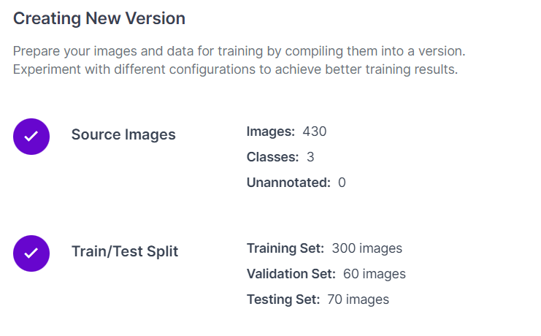

Slide 14
STEP 5: MODEL SELECTION
Objective: To build a robust object detection model for cups, mice, and spoons.
Options: Various models available for object detection, including Faster R-CNN, SSD, and YOLO (You Only Look Once).
Choice: Selected YOLO v8 model for its efficiency and accuracy.
YOLO v8 Advantages:
Speed: YOLO v8 is known for its fast inference speed, making it suitable for real-time applications.
Accuracy: Provides competitive accuracy compared to other models, ensuring reliable object detection.
Simplicity: YOLO v8's single-stage architecture simplifies the training and deployment process.
Customization: YOLO v8 allows for easy customization and adaptation to specific project requirements.

Slide 15
YOLO WORKING
Objective: To build a robust object detection model for cups, mice, and spoons.
Single Shot Detection: YOLO is a single-stage object detection model that predicts bounding boxes and class probabilities directly from full images in one evaluation.
Feature Extraction: Employs a convolutional neural network (CNN), such as Darknet, to extract features from the input image.
Grid Division: Divides the input image into an 𝑁×𝑁 grid.
Bounding Box Prediction: Each grid cell predicts multiple bounding boxes along with confidence scores.
Class Prediction: For each bounding box, YOLO predicts the class probabilities.
Non-Max Suppression: Post-processing step to remove duplicate boxes and refine the final predictions.
Output: Provides a final list of bounding boxes with corresponding class labels and confidence scores.

Slide 16
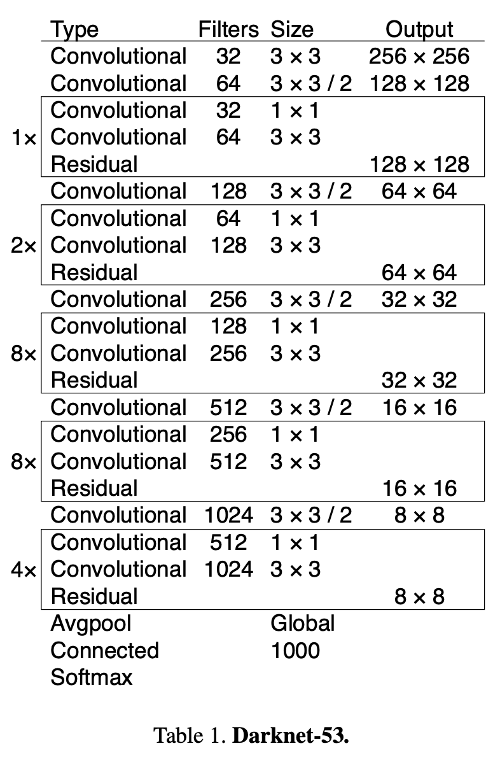
DARKNET 53 ARCHITECTURE

Slide 17
MODEL TRAINING
Objective: To build a robust object detection model for cups, mice, and spoons.
Training Time
Trained the model for a total of 11 hours.
Used 311 epochs for training.
Training Process
Overnight training on the training images.
Used the YOLO v8 model architecture.
Validation Output
Saved the output for the validation images.
Stored in the "runs" folder for analysis.
Model Accuracy
Monitored and recorded model accuracy parameters.
Results
Achieved a high level of accuracy on the validation set.
Model is ready for deployment and inference on new images.

Slide 18
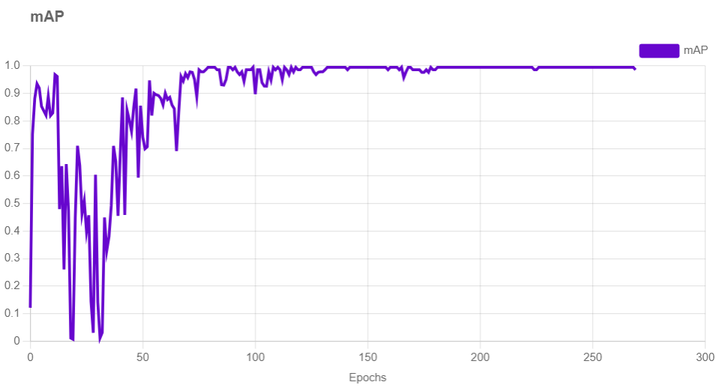
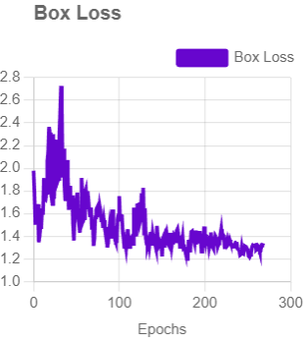
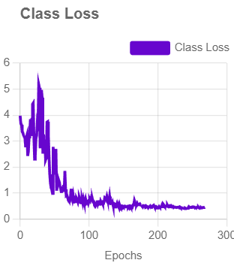
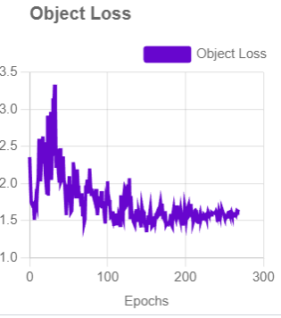
Training Graphs

Slide 19
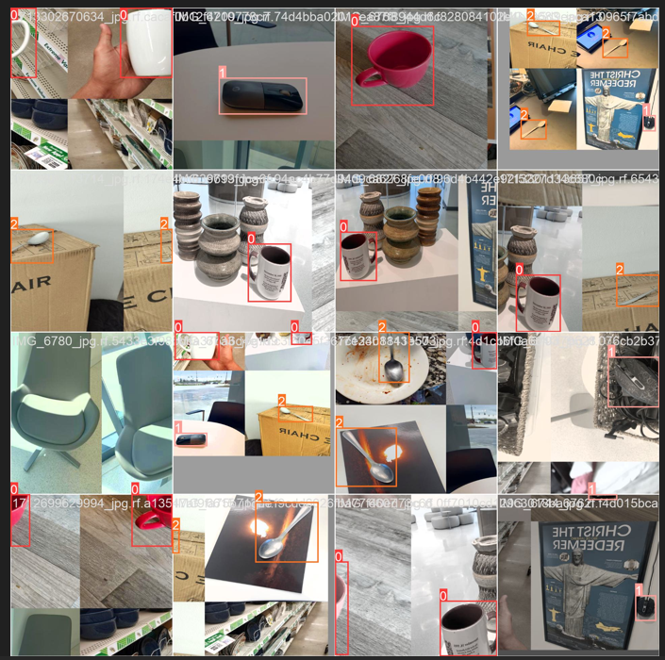
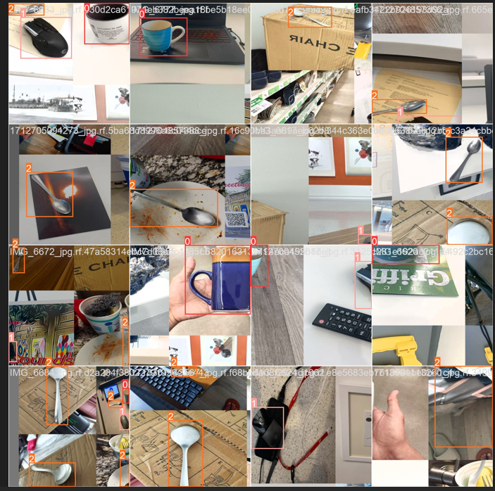
TRAINING DATASET
Objective: To build a robust object detection model for cups, mice, and spoons.

Slide 20
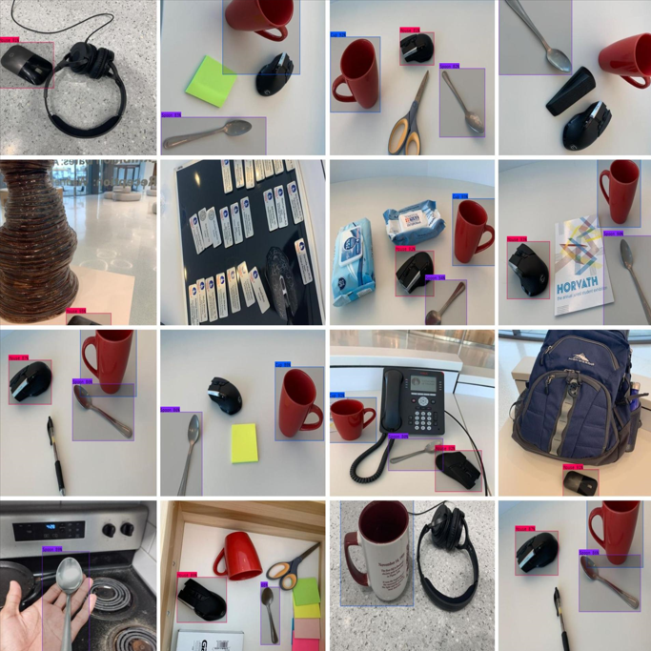
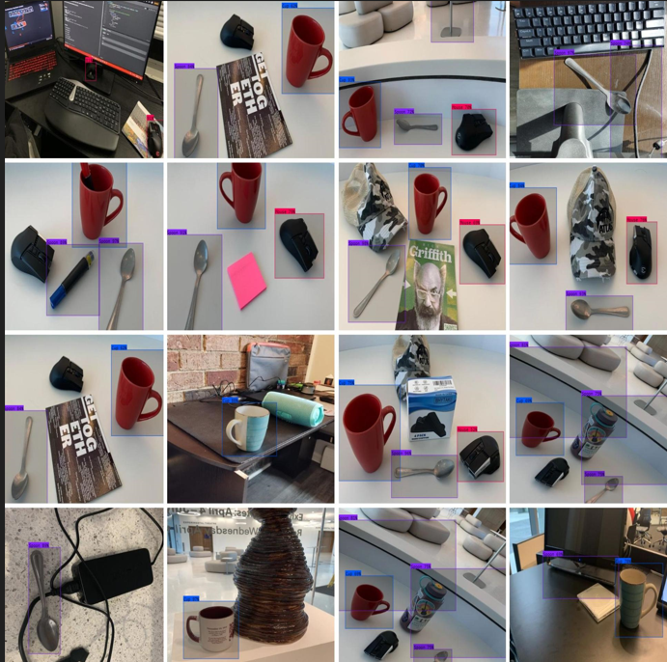
Predictions

Slide 21
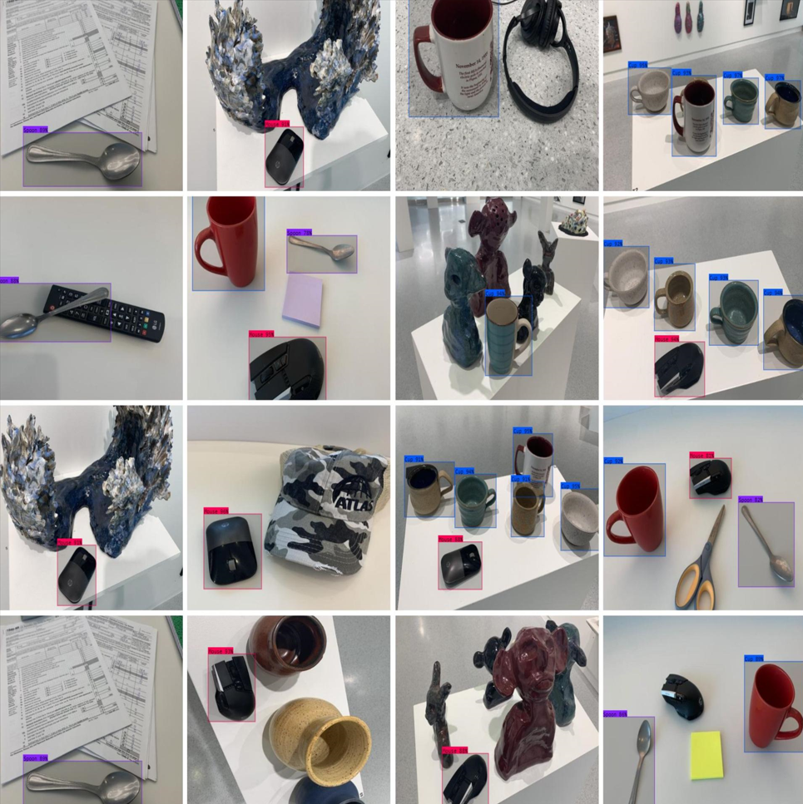
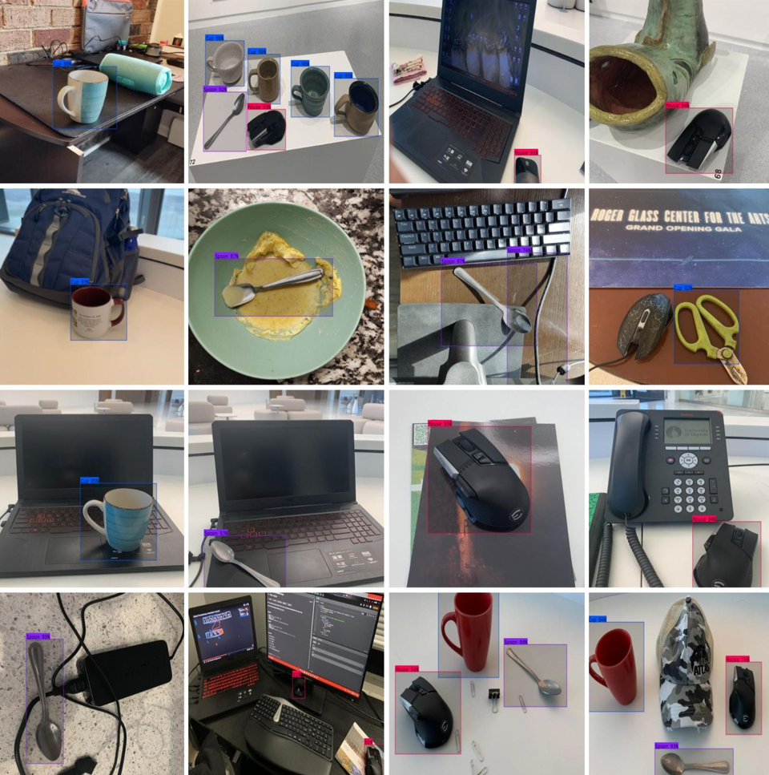

Slide 22
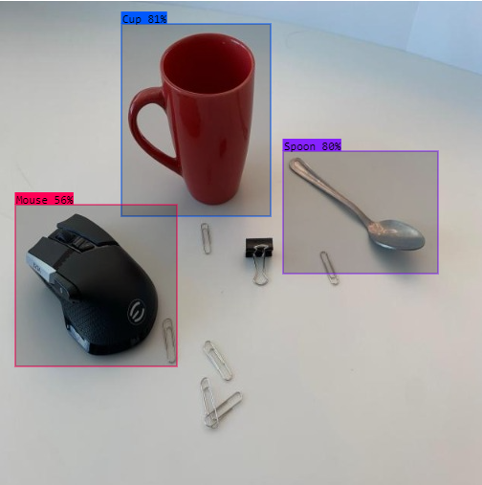
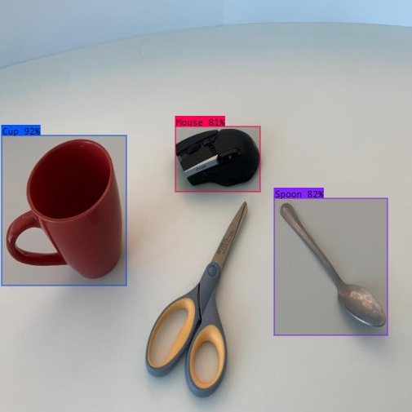
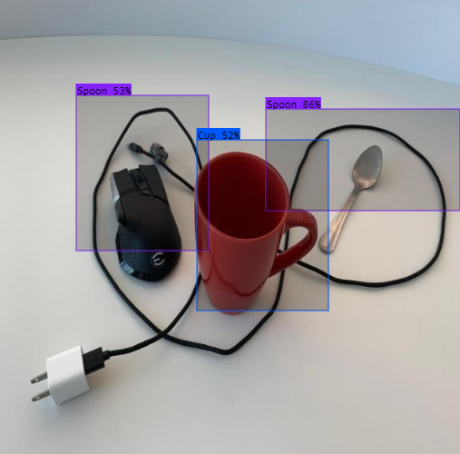

Slide 23
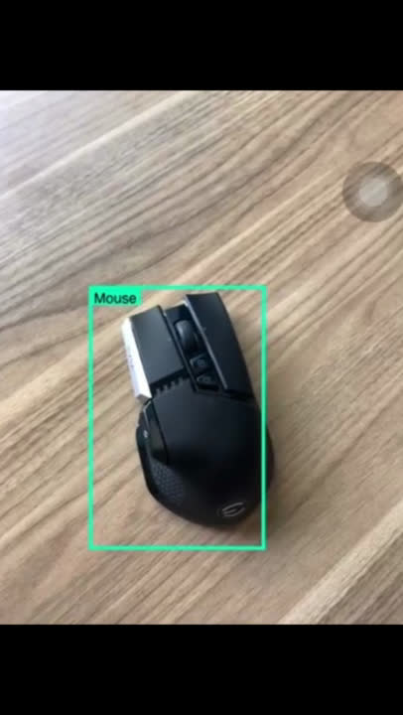
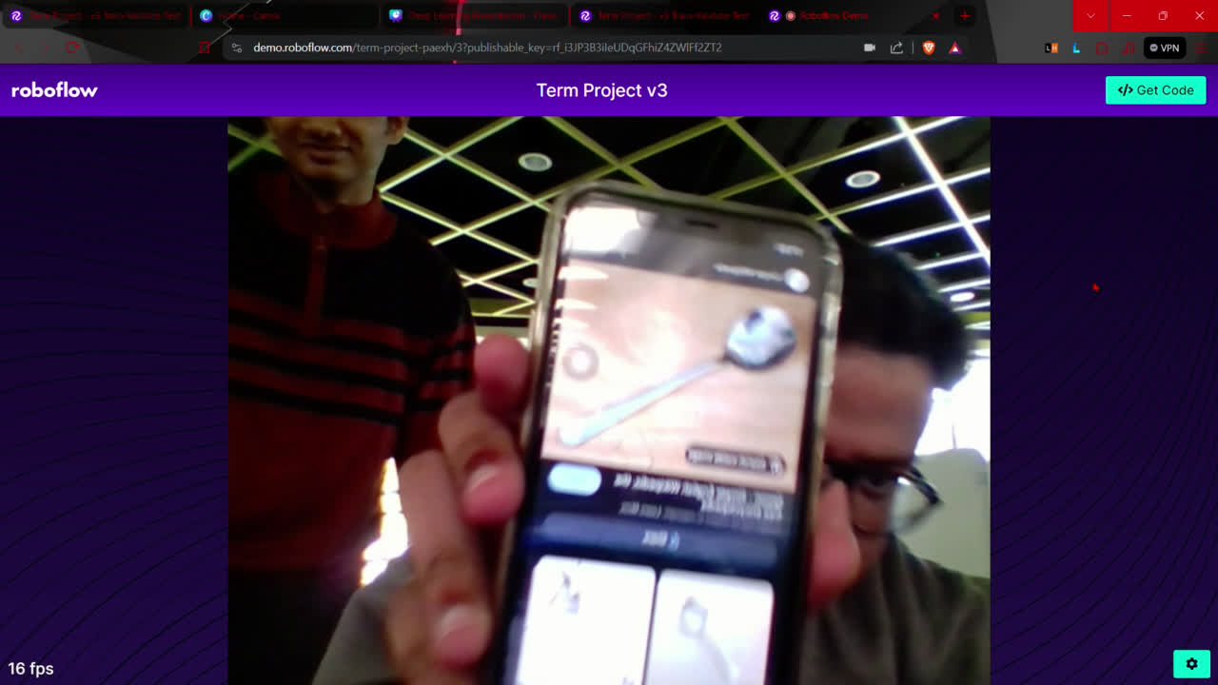
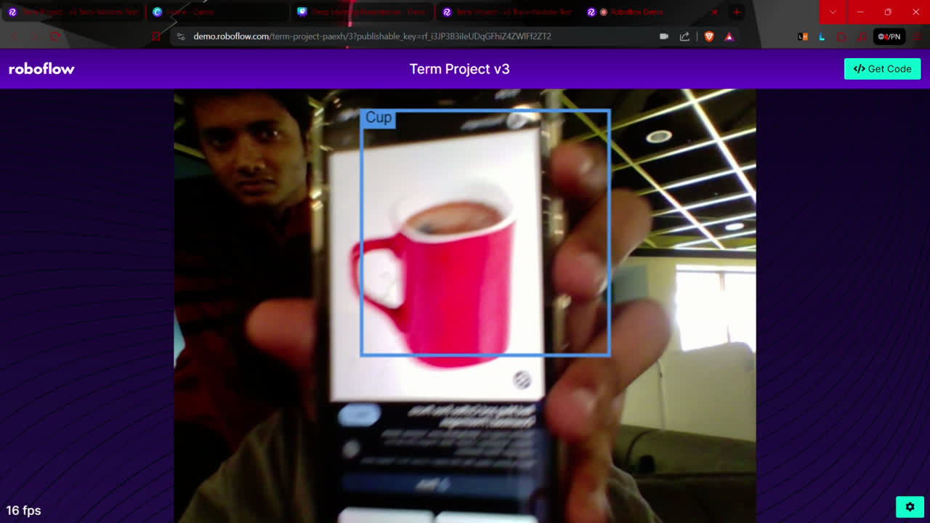
Camera Deployment

Slide 24
GENERATING LANDSCAPE IMAGES WITH CONDITIONAL GAN
Conditional GAN Architecture
Used Conditional Generative Adversarial Network (GAN)
Generator takes in a random noise vector and a one-hot encoded label (landscape sketch)
Discriminator receives generated images and corresponding labels
Training Process
Trained on a dataset of 1469 landscape images
Images preprocessed and resized for training

Slide 25
